Slide 1
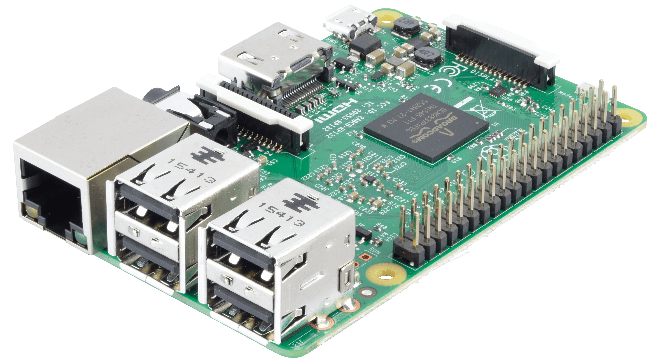
RASBERRY PI WORKSHOP
By:
Krishna Kumar Sah
E. E. COM.
Firmware Engineer
Real Time Solutions

Slide 2
Introduction to raspberry pi – 3 (Model B)
The Raspberry Pi is a credit-card sized computer that plugs into your TV and a keyboard, which can be used for many of the things that your average desktop does - spreadsheets, word-processing, games and it also plays high-definition video.
The Raspberry Pi is a charitable foundation.
Maintained by partners as well as opensource community.
• Why so cheap ?
• SoC - System on a chip, a computer on a single low voltage chip
• Linux OS

Slide 3
Introduction Cont.
Linux on a bootable SD card
Fedora
Debian
ArchLinux
Windows 10 IOT core
UBUNTU MATE
PINET
RISK OS, etc

Slide 4
Installation
Step by step installation
Go to https://www.raspberrypi.org/downloads
Main operating used Raspbian
But we use NOOBS (New Out of Box Software), a Raspbian offline installer
Download SD-card Formatter (MAC not required, Linux use gparted)
Format the SD –card using SD-card Formatter
Extract the downloaded file into the SD-card.
Install : Select Raspbian

Slide 5
Introduction Cont.
By default, supporting Python as the educational language.
Any language which will compile for ARMv6 can be used with the Raspberry Pi, though; so you’re not limited to using Python.
E.g C, C++, HTML, PHP, java etc ..

Slide 6
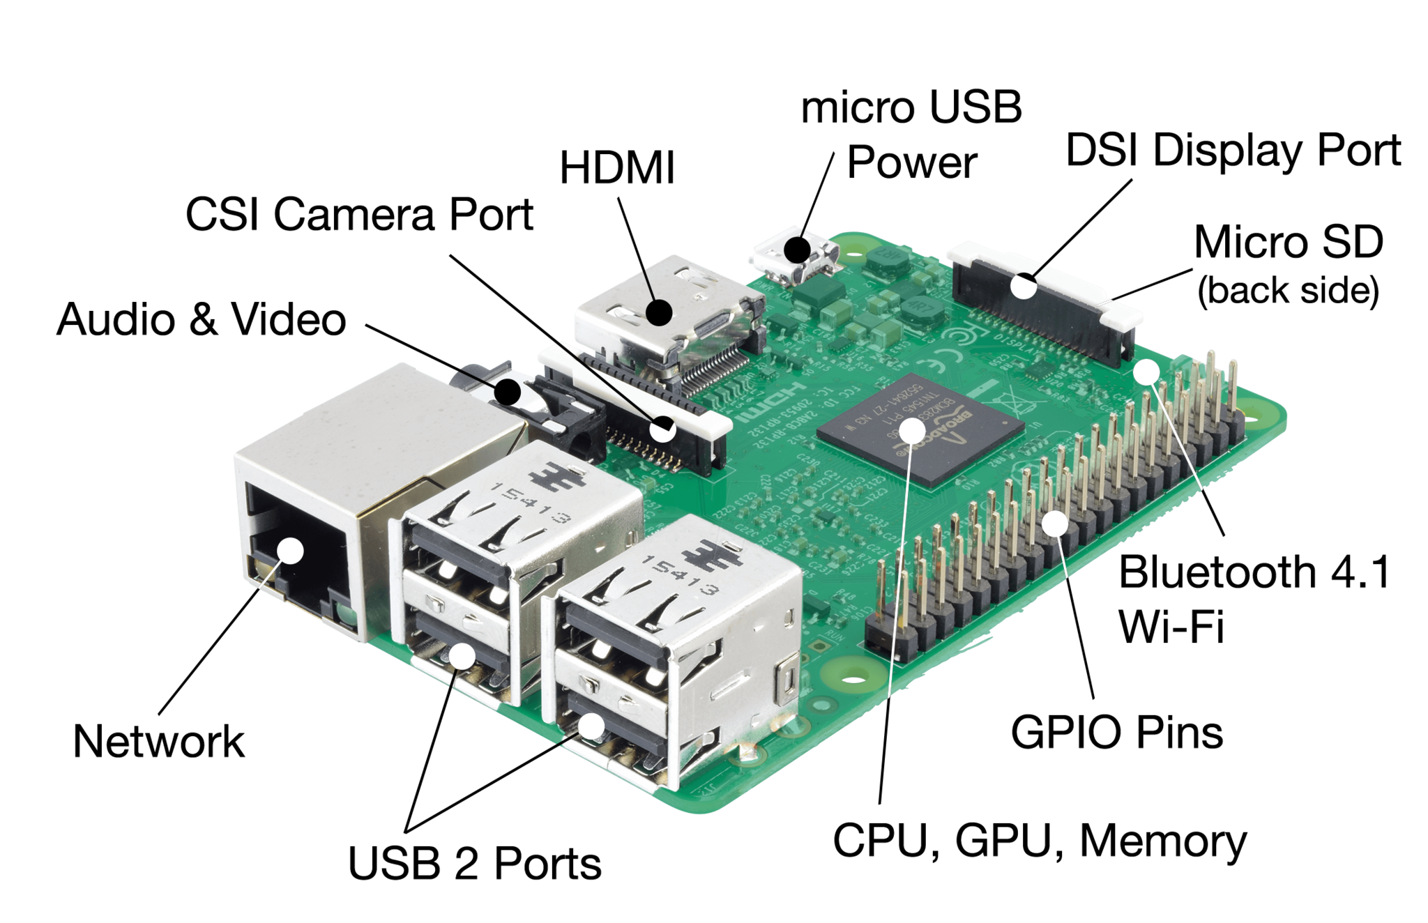
Introduction Cont.

Slide 7
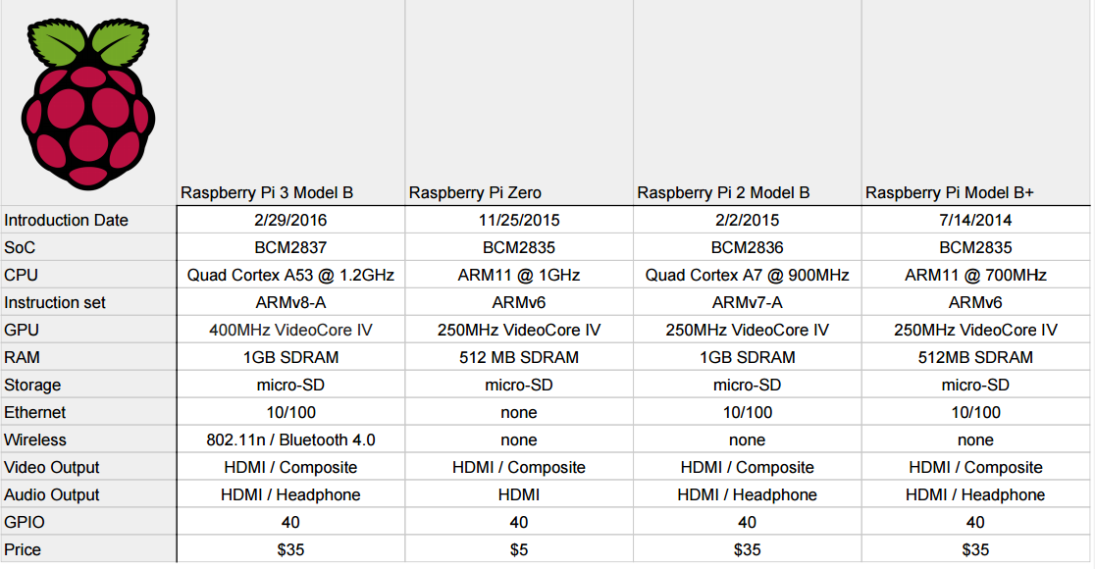
Introduction Cont.
Specifications:

Slide 8
Introduction Cont.
Key Improvements from Pi 2 Model B to Pi 3 Model B:
Next Generation QUAD Core Broadcom BCM2837 64bit processor
Processor speed has increased from 900MHz on Pi 2 to 1.2Ghz
BCM43438 WiFi on board
Bluetooth Low Energy (BLE) on board
Upgraded switched power source up to 2.5 Amps (can now power even more powerful devices over USB ports)

Slide 9
Introduction Cont.
Other Technical Specification:
40pin extended GPIO
4 x USB 2 ports
4 pole Stereo output and Composite video port
Full size HDMI output
CSI camera port for connecting the Raspberry Pi camera
DSI display port for connecting the Raspberry Pi touch screen display
Micro SD port for loading your operating system and storing data
Upgraded switched Micro USB power source (now supports up to 2.5 Amps)
The same form factor as the Pi 2 Model B, - the only difference is the location of the onboard LEDs

Slide 10
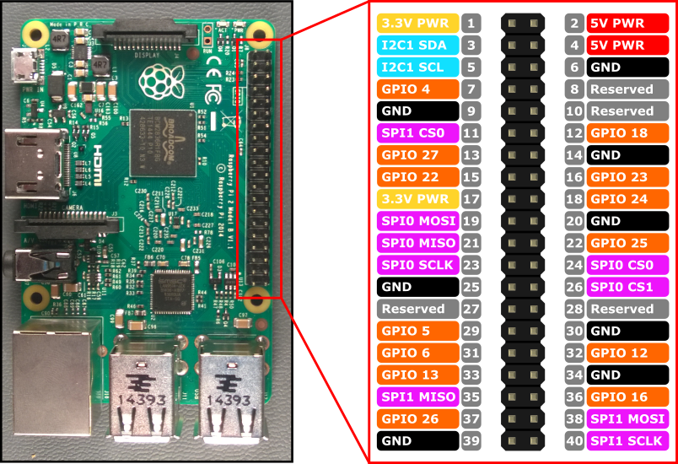
Introduction Cont.

Slide 11
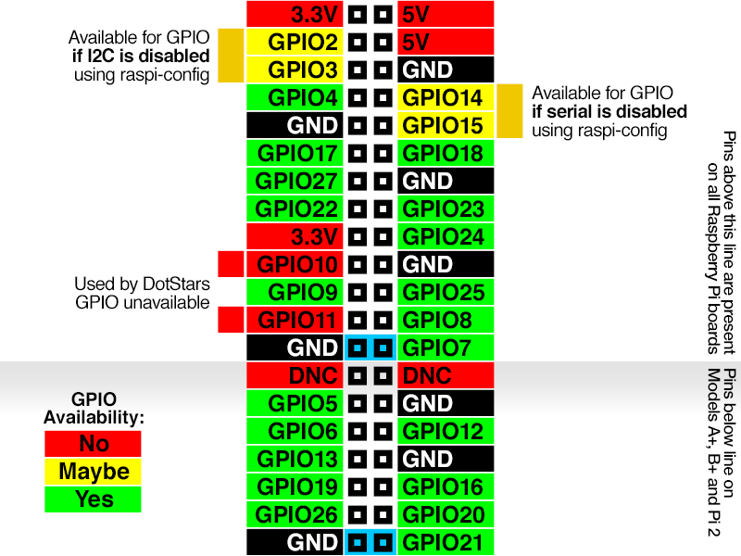
Introduction Cont.
The square sapped interface always start with pin number one.

Slide 12
Remote accessing raspberry pi
Open terminal : Ctrl + alt + t
$ ifconfig
Show ip address and other details
$ sudo raspi-config
Opens config window
(SSL: secure shell)

Slide 13
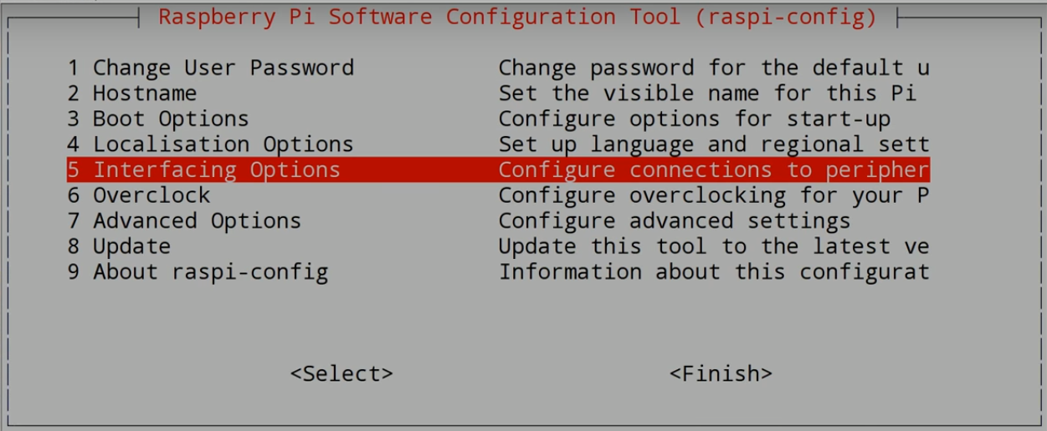
Remote accessing raspberry pi

Slide 14
Remote accessing raspberry pi
Navigate to Interfacing option
Navigate to SSH (Secure Shell) : for bash
Enable
ok
Navigate to VNC (Virtual Network Computing) : for graphical
Enable
Ok
Finish

Slide 15
Remote accessing raspberry pi
Finding out Ip address: $ ifconfig
For windows user download PUTTY software
For linux user just type
Ssh [username]@[ip-address]
Default username_name : pi
Default password : raspberry
If unable to connect ssh:
$ ssh-keygen –R “ip-address-of-ur-pi”
Lots of other bash terminals can be used for ssh
Windows : putty, bash of git, tera term, etc
Linux : terminal

Slide 16
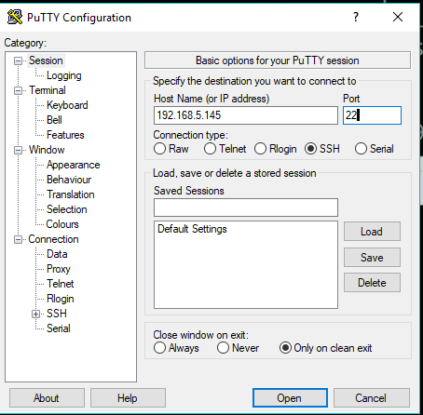
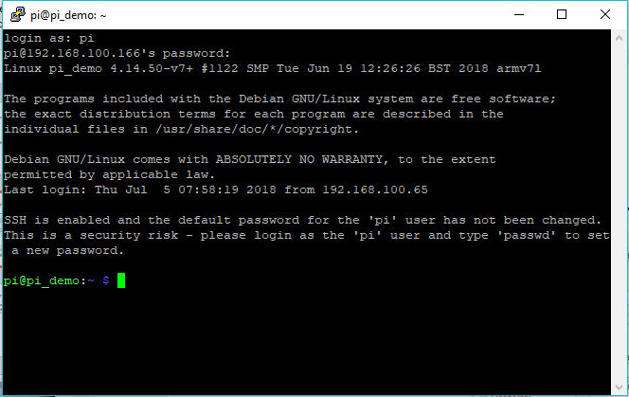
Remote accessing raspberry pi

Slide 17
Remote accessing raspberry pi (GUI)
We need to remove old vnc server and tight vnc server (clean)
$ sudo apt-get remove xrdp vnc4server tightvncserver
$ sudo apt-get autoremove
$ sudo apt-get autoclean
Install new vnc server
$ sudo apt-get install tightvncsetver
$ sudo apt-get install vnc4server
$ sudo apt-get install xrdp
XRDP shall restart by default if not
sudo /etc/init.d/xrdp restart
vncserver :0
(XRDP : remote desktop protocol)

Slide 18
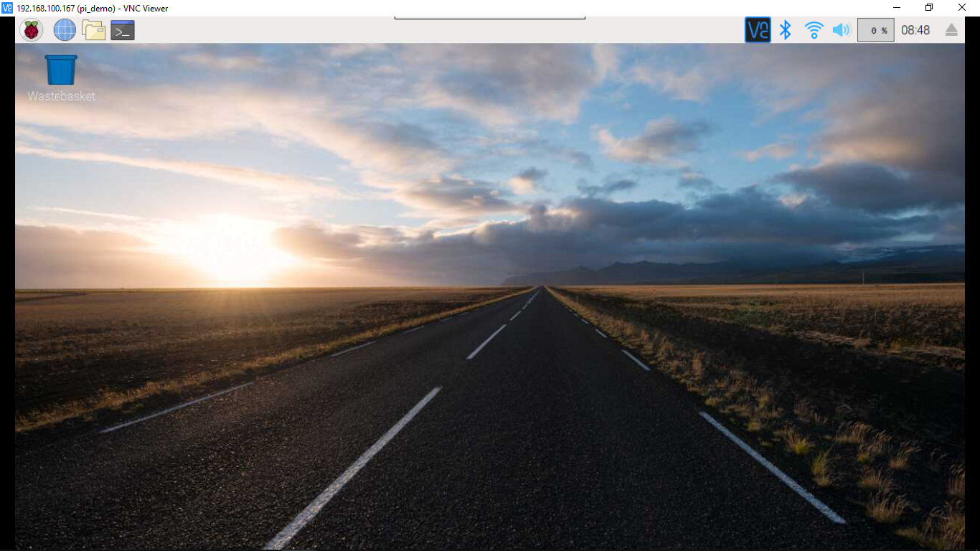
VNC Viewer:

Slide 19
Remote Desktop:
For windows search : remote desktop connection (pre-installed)
If not installed : install
Enter IP
Say yes
User name : pi
Password : raspberry

Slide 20
Tera Term:
Install Tera term:
Enter ip
Username
Password
Bash windows:
$ ssh pi@192.168.100.166
$ say yes
$ password : raspberry

Slide 21
Update and upgrade
Commands to update and upgrade: (ctrl + alt + t : open terminal)
$ sudo nano /etc/apt/sources.list
This will open sources.list file in nano editor
Go to the line starting with deb and deb-src
Ctrl + k to remove line
Copy and lines below:
deb http://archive.raspbian.org/raspbian jessie main contrib non-free
deb-src http://archive.raspbian.org/raspbian jessie main contrib non-free
Ctrl + x to exit and y to save
$ sudo apt-get purge wolfram-engine
Since the size is lower we remove wolfram engine (not required)
$ sudo apt-get autoremove
$ sudo apt-get dist-upgrade
This will take little time and say ‘y’ if asked to continue
$ sudo apt-get update
$ sudo apt-get upgrade

Slide 22
Thanks for today …

